Slide 1
The Institute for Continuous Improvement in Public Services
Membership via portfolio

Slide 2
Before you can start
Learning account
Once payment is cleared you will be sent details of how to log into your learning account.
The learning account contains:
Guidance notes
Additional support materials
Competencies
Details of others in your cohort who are happy to be contacted
A place to log evidence of continued development
Sign up as Affiliate on the join now page.
You will be sent an invoice for the annual member fee.
If this is being paid by your employer, send a billing address and Purchase Order number to info@icips.org

Slide 3
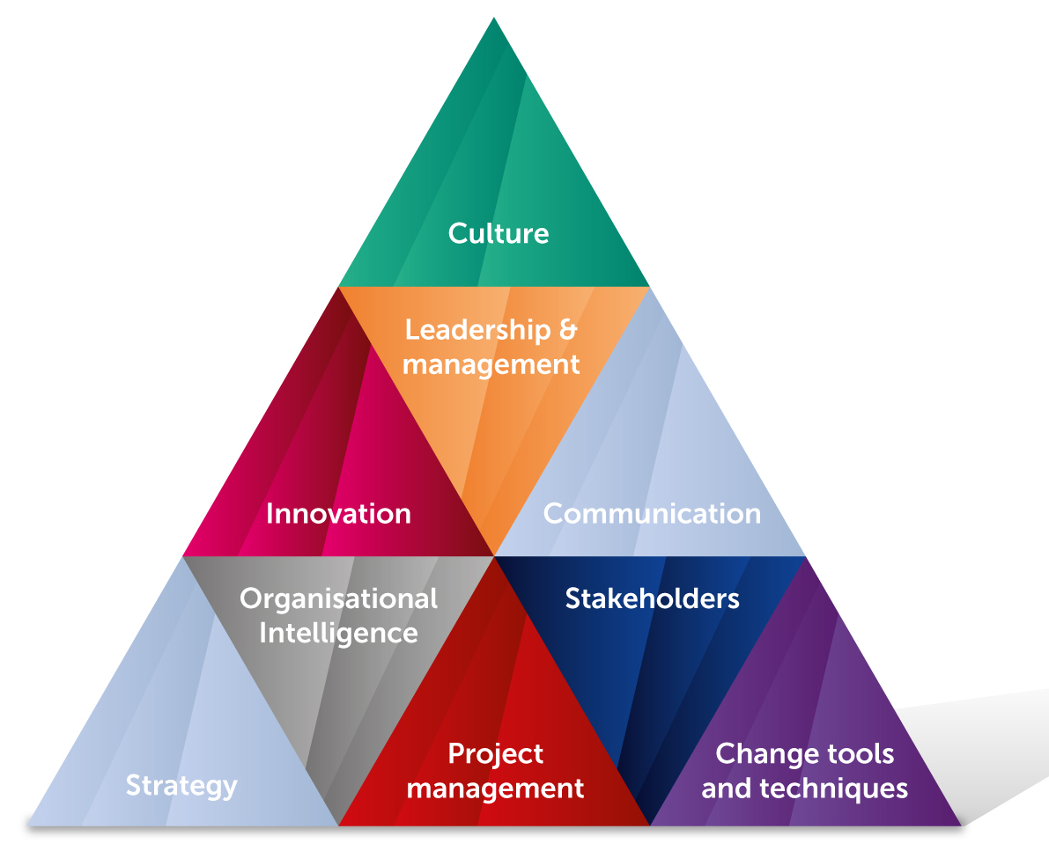
What you need to do
You may use the same evidence multiple times, complete the modules in any order and request feedback at any stage.
Once complete, evidence provided will be retained for one year for internal moderation purposes. It will be viewed only by assessors.
We understand it is not always possible to secure evidence, especially where you have changed your job. We therefore allow for two points in each assignment to be covered during the professional discussion.
Demonstrate you meet our standards of practice; by uploading relevant evidence against a series of competencies.
The competencies cover the areas shown below. Member focuses on on practical techniques; Practitioner on cultural aspects and Fellow on strategic aspects.
There is no time limit.

Slide 4
Quantity and quality of evidence
Ho
Evidence - Case studies & extracts from your work
We seek quality and relevance, not quantity.
You must pay attention to every word in every competency as they spell out what we are looking for and how we wish you to demonstrate understanding, e.g.
‘Describe’ we would expect you to explain
‘Discuss’ we would expect you to reflect on something from a variety of perspectives
Be careful that you don’t just address half the statement, every word is there for a reason – it must be covered.
You may present case studies & examples of your work, that clearly demonstrates your involvement and / or behaviour. If they do not, you will need to produce accompanying narrative explaining your role.
Evidence should be no more than 5 years old.
Contact details for a referee must be provided and ICiPS may contact them to validate your evidence.
Please remove any sensitive data before submitting.

Slide 5
Evidence - Witness Testimony
Evidence - Narrative
Witness testimony may be used to evidence behaviors. A witness testimony is a sworn statement to confirm a behaviour has been observed.
30% of competencies may be evidenced by witness testimony which must :
Confirm the behavior in question
Describe the circumstances in which they observed you display the behaviour
Be on headed paper, dated and signed by the testifier
Refer to you by name
State the testifiers’ relationship to you
You may produce written work detailing how and when you displayed a behavior or applied your knowledge. You must also provide contact details of a referee who is prepared to confirm your statement is accurate.
You may produce narrative to evidence underpinning knowledge; enabling self-development through research and reading. You may reference information from the internet but must not copy wholesale. We are seeking evidence that you have undertaken research and understand the concepts in question.

Slide 6
Other evidence
Annual appraisal
To evidence behaviors you may present your appraisal for the current or previous year. Please blank out anything that does not relate to the competency.
Prior learning
Certificates confirming prior learning can be uploaded against relevant underpinning knowledge competencies; these areas will be tested during your professional discussion.
If training was undertaken by an ICIPS Recognised supplier, you will receive automatic entry – please see details on our fast-track page
CI passport
In the course information you will find a CI passport which contains competencies that can be signed off in the workplace.
This enables you to capture confirmation of capability, knowledge and Behaviours, on the job.
It must be signed off by a senior manager, with their contact details provided.
Once some, or all of it is completed you may upload it as evidence.

Slide 7
After completing a competency
The final stage of assessment
Once you have completed a competency you may submit if for assessment.
You will either receive a message saying it has been signed off, or detailed guidance on what additional work is required.
You can request a meeting to discuss any areas you are not sure about either using the learning portal, or email training@icips.org.
Once all assignments are complete, you will be contacted to arrange a time for a professional discussion. The purpose is to talk through some of the evidence presented, or areas where more evidence is required.
The discussion is held by phone or online and takes around 45 minutes
If the assessor is satisfied that everything is complete; you will be informed either that professional membership has been awarded or more work is required.

Slide 8
Don’t struggle
Paying for membership
If you are struggling, you can contact ICIPS for support, either through your learning account or directly at info@icips.org
As people move to our new learning platform, cohort members can elect to make their email details visible to others in their cohort, for informal support.
As an alternative option you can elect to take an on-line, fully invigilated exam instead. The charge for this option is £85.00 for each attempt.
On offer of professional membership, you will be sent an invoice for the annual fee.
If your fee is being paid by your employer, you should provide a billing address and a PO number.
If you are a Corporate member, the fee is prepaid.
Once paid, you will be sent a certificate and badge and so long as you are a paid-up member, you may use letters after your name and our logo tag.

Slide 9
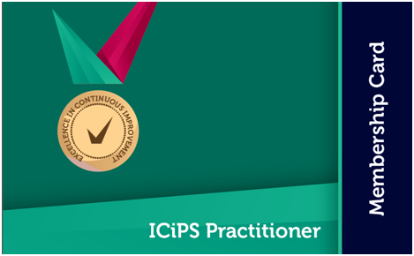
Continuing Professional Development (CPD)
Want to progress through the grades?
Following award of membership, you are expected to undertake a minimum of 8 hours CPD a year to ensure you develop your knowledge and skills.
CPD should relate to an area of the ICIPS competency framework. It could include:
Self study
Applying new practices at work
Attending webinars or training sessions
Problem solving situations
Activities at team meetings
You need to state what the activity is and what you learned from it.
You can log CPD in you learning account, linking it to a specific competency. This can be used as evidence if you wish to progress up the grades.
Moving through the grades is a case of building on your evidence to demonstrate a broader range of knowledge and experience.
There is no charge, unless you choose the exam route. See exam page for details
Simply let us know, and the relevant competencies will be uploaded to your learning account.

Slide 10
Professional services
Free support, guidance and knowledge for members
Custodians of professional practice for continuous improvement
www.icips.org
07906 623432

